Slide 1
Unit 2
The Olympic Games
friends
Reading

Slide 2
本节课是关于奥运会的阅读课，奥运会是学生熟悉而且也很感兴趣的话题。首先，用奥运会五环旗及其象征意义导入，自然的延伸到比赛项目，而且是用动画图片的形式，其中穿插了北京奥运会的焰火视频，把学生对这一话题的兴趣推向极致。
在阅读部分，设置了简答题，填空题等来训练学生的skimming, scanning技巧，提高他们的阅读能力，让学生深层次的理解文章内容。

Slide 3
united
团结
equity
Europe
Africa
America
平等
open
Asia
Oceania
坦城
friendship
友谊
The five interlocking rings stand for friendship of five continents.

Slide 4
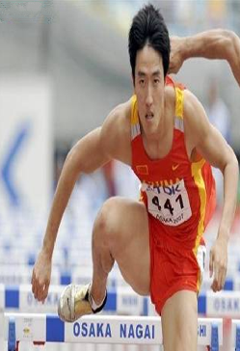
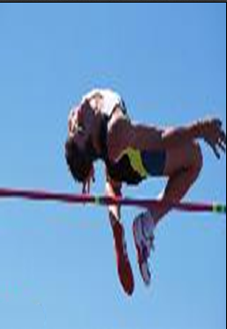
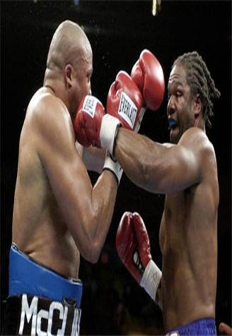
the Olympic motto
Stronger
Higher
Swifter

Slide 5
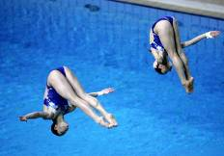
What events(比赛项目) are there for the Summer Olympics?
football
baseball
swimming
Table tennis
diving
Wrestling

Slide 6
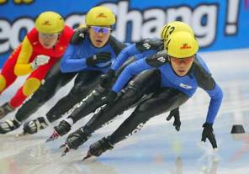
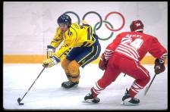
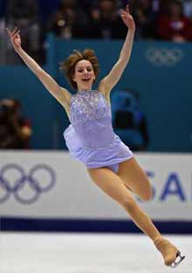
What events are there for the Winter Olympics?
skiing
skating
figure skating
花样滑冰
Ice ball

Slide 7
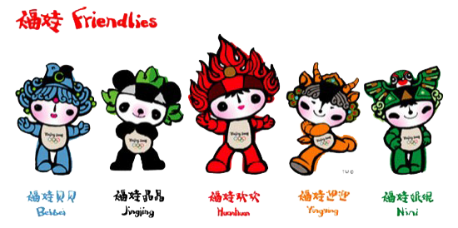
Olympic Mascot 奥运吉祥物
It is a special kind of animal that represents the country which host the Olympic Games.
奥运吉祥物多为举办国民族文化中拟人化的动物，使奥运会更加诙谐而富有人情味。
吉祥物始于1972年第20届奥运会。当时的吉祥物是一只小猎狗。

Slide 8
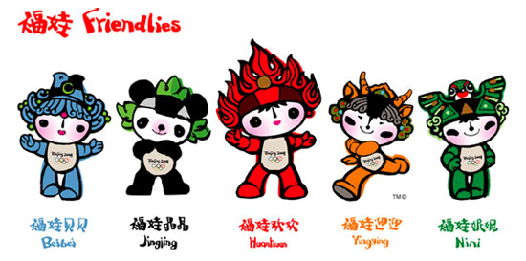
2008 Beijing Olympic Mascots
Welcome to Beijing

Slide 9
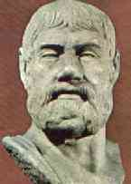
Pre-reading
When and where will the next Olympic games be held?
London, in 2012
Do you know any differences between the ancient and modern Olympic games?
List at least two of them.

Slide 10
Reading
Task 1: Skim the passage and gethe the main idea of the passage.
1. What are they mainly talking about?
The similarities and differences about the ancient Olympics and modern Olympics.

Slide 11
Differences
Items | The ancient olympic games | The modern olympic games
Frequency | 1. Every _____ years | 2. Every ____ years
four
four

Slide 12
Types | Only Summer olympic games | Summer and 3._______ olympic games
Events | Fewer | 4._____
winter
more

Slide 13
Items | The ancient olympic games | The modern olympic games
Athletes | Only men from 5. ______ city | From 6.________ _____________ including 7. __________
all over
Greek
the world
women

Slide 14
similarities
having running races
held every four years
no prize money for winners
the same motto: Swifter, Higher and Stronger
seen as most important competition

Slide 15
Answer the following questions
1. What amazes Pausanias about the
Olympic Games?
Pausanias is amazed that many countries take part in the Olympic Games and women too and there are two sets of Games – the Winter and the Summer Olympics.

Slide 16
2.Why does he think Athens and Beijing should feel proud?
Because Li Yan has explained that it is a great honour to host the Olympic Games.

Slide 17
3. Why does he think people may be competing for money in the modern Olympic Games?
He think that so many things have changed in the Olympic Games that he fears that the spirit of the Olympics may have changed too.

Slide 18
4.What makes Pausanias happy about the modern Olympic Games?
The modern Olympic Games have more events. Every country wants to host it. It shows that the Games are popular with the whole world. It is just a competition not for money.

Slide 19
Find out words, expressions and sentences which you think are useful, important or difficult to understand.
Finish exercises in Learning about language.

Slide 20
Unit 2
The Olympic Games
Vocabulary

Slide 21
本课件主要是讲解重点单词和短语，并且对文中出现的长句做了解析.
首先，让学生翻译一些关于奥运会的短语作为导入，同时，也扩大了他们的词汇量和知识。单词和短语讲解部分，既有多个短语的扩展，也有同个单词多个词型的扩展，在讲解后及时巩固，而且，巩固题型多样化，题目精细化，能帮助学生最大程度的内化为自己的知识。

Slide 22
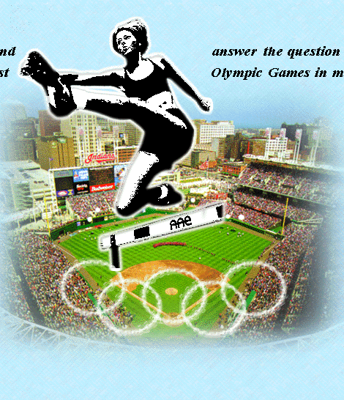
Lead in :
Translating the following into English:
古代奥运会
现代奥运会
金牌获得者
第27届夏季奥运会
奥林匹克精神
the ancient Olympic Games
the modern Olympic Games
gold medal winner
the 27th Summer Olympics
The spirit of the Olympic Games
The Olympic spirit
主办奥运会
to host the Olympic Games

Slide 23
1. compete vi. 比赛，竞争，竞赛
compete in…在某方面竞争
compete for…为……而竞争
compete with/against 与……竞争
competition n.竞赛
competitor n. 参赛者
competitive adj. 有竞争力的

Slide 24
即学即练
1. She decided to compete _____ the model contest.
2. Several companies are competing ____________ each other for the contract.
3. We don’t only compete _____ medal, but friendship.
in
against/with
for

Slide 25
2.take part in, join, join in, attend的区别
join 加入(某党派、某组织或某社会团体)
join in 参加，参与（活动）
take part (in) 参加，参与（活动）＝ join in
join sb. 和某人一起……
join sb in sth./doing sth. 和某人一起做……
attend表示参加会议（聚会）等
take part in/join in
May I ___________________ the game?
____ the Party/ League/ army/ a club
Why not ___________ playing basketball?
join
join us in

Slide 26
即学即练
1. Our headmaster will___ us in the
discussion this afternoon.
A. take part in B. join in
C. join D. attend
2. How many ___ will you ___?
A. incidents, join B. events, join in
C. accidents, attend D. games, enter
C
B

Slide 27
3. My grandpa was in the Red Army,
and he ___ the Long March.
A. joined B. took part in
C. attended D. join
4. There will be a lecture tomorrow;
all those who want to ___, please raise your hands.
A. join B. attend
C. take a part D. take part in
B
B

Slide 28
3. Pausanias, who was a Greek writer 2,000 years ago, has come on a magical journey to find out about the present day Olympic Games. (P9)
Pausanias是2000前的一位希腊作家，他做了一次魔幻的旅行，来打听当代奥林匹克运动会的情况。
find out about 弄清有关……的情况
eg. The police are trying hard to find out about the accident.
警察正尽力查出事故的情况。

Slide 29
find /find out / discover
It’s so boring to wait here, John, go to _______ when the plane will arrive, will you?
(2）On the way home I _____ a watch lying on the road.
(3) They’re trying to ________ the secret.
(4) Columbus __________ America in 1492.
(5) Can you ________ Mr. Liu’s address for me?
find out
found
find out
discovered
find out

Slide 30
注意:
find out 经过努力有意的去“找， 打听，弄清楚”。
find 找到，发现某东西
discover 发现本来就存在但尚未被人发现的东西

Slide 31
4. interview 采访, 会见, 面试
eg. Tomorrow I’ll have an interview for a new job.
n. have an interview
a job / telephone / TV interview
I interviewed 20 people for the job.
v. interview sb.
interviewer(采访者)
interviewee(被采访者)

Slide 32
5. I lived in what you call “Ancient Greece” and I used to write about the Olympic Games more than 2,000 years ago. (P9)
我生活在你们所说的“古希腊”，我曾经写过
２０００年前奥林匹克运动会的情况。
what 引起宾语从句，并在从句中作call的宾语，“Ancient Greece”作宾补。
eg. After a long journey, they came to what was called “Gebi Desert”.

Slide 33
即学即练
1. After a long journey, they come to
____ was called Chinatown.
A. what B. that C. which D. the place
2. At the dinner party they talked about
the people and things ___ they
remembered in senior high school.
A. which B. that C. what D. whom
A
B

Slide 34
过去经常做某事（现在不做了）
6.used to do sth.
be/get used to doing sth.
be used to do sth.
eg. He is not used to getting up early.
Wood can be used to make paper.
She used to live in that city.
习惯做某事
被用来做某事
他不习惯早起
木头可用于造纸。
她以前住在那座城市里

Slide 35
7. …and both are held every four years on a regular basis.
A.every+基数词+复数名词（或+序数词+单数名词）
每两年（每隔一年）
every two years/every second year
每四天（每隔三天）
every four days/every fourth day

Slide 36
Only athletes who have reached the agreed standard for their event will be admitted as competitors.
只有达到他们各自项目标准的运动员才会被接受参加运动会
B. admit (admitted, admitted) 容许, 承认, 接纳
(1)The thief admitted his crime.
(2)I had to admit that I had done wrong.
(3)She admitted having stolen the necklace.
admit sth. / admit doing sth. /admit that-clause

Slide 37
(4)At last he was admitted to Beijing University.
(5) He was admitted as a member of the baseball team.
be admitted to 让……进入,获准做某事
be admitted as 作为……被接受

Slide 38
即学即练
1. Her mother ___ having read the letter.
A. thought B. considered
C. admitted D. advised
2. He admitted _____ a lie.
A. telling B. to tell C. to telling D. tell
3. It was lucky for him to be admitted ____ the dream university he had longed for.
A. as B. to C. with D. for
C
A
B

Slide 39
It’s in the summer Olympics that( you have the running races, together with swimming, sailing and all the team sports.)
跑步，游泳，划船和一些团体项目是在夏季运动会上进行。
句子结构：强调句+together with.
只有多训练, 你才能提高你的听，说，读，写能力。
It is by practicing more that you can improve your listening ability, together with speaking ability and writing ability.

Slide 40
8. No other country could join in, nor could slaves or women.
nor 用作连词，引起倒装句，意为“也不”。
---Do you know Jim quarreled with his brother? ---I don’t know, _____. A. nor don’t I care B. nor do I care
C. I don’t care neither D. I don't care also
B
1) Tom can speak French. _____ can Jack.
2) 一I won't do such a thing.
－_______________will I．
So
Neither／Nor

Slide 41
. I didn’t go there. _________________
her. (她也不去)
(2). She was a teacher. _________ I.
(我也是这样)
(3). 我没有去过北京，我也没有计划过去。
Nor /neither
did
So was
I have never been to Beijing. Nor have I planned to go there.

Slide 42
9. Women are not only allowed to join in but (also) play a very important role especially in…
a. allow vt. 允许
eg.The law doesn’t allow such an action.
My parents won’t allow me to stay out late.
The police don’t allow parking in the street.
allow + n. 允许……
allow sb. to do 允许某人做……
allow + doing 允许干……
b. play an important part/ role in…

Slide 43
10. as well as
(1) 同级比较，“与…一样好”
翻译：你的作业完成的跟他一样好。
(2)既……又；也；又。
连接并列主语时，谓语应与前面的主语保持人称和数的一致.
eg: I as well as my sisters am going to the park for a picnic this Sunday.
as well as后接动词时，一般用ing形式。
填空：1）The teacher as well as some students_______(be) interested in the question.
2) She sings as well as _________ (play) the piano.
You have finished the homework as well as he.
was
playing

Slide 44
11. Does anyone want to host the Olympic Games?
host ( v.)主办；举办
你认为中国何时会举办世界杯？
When do you think China will host the World Cup?
host (n.) 主人
She was away, so her son acted as host.
她那时不在家，所以由她的儿子来招待客人

Slide 45
1. Finish exercise 1 &2 .
2. Underline sentences in the reading passage that use the –ing form.

Slide 46
Unit 2
The Olympic Games

Slide 47
本课件主要是介绍一般将来时的被动语态，并且对将来时的几种常考的用法都做了列举。
首先，在讲一般将来时之前，复习了常考的八种时态的被动语态，主要还是让学生更好的比较，掌握住每种时态特别是将来时的被动语态。将来时的常用的五种被动语态分别以实例的形式展现，方便学生理解。在之后的练习巩固环节，精选了题目，而且，题型涉及到填空、改错和单选，让学生当堂完成，及时巩固。

Slide 48
Grammar
The passive voice

Slide 49
☆被动语态的时态是由be的时态决定的，be是什么时态，全句就是什么时态，be后面的过去分词不变。

Slide 50
时态 | 主语 | 单数 | 复数 | 过去分词
一般现在时 | The car/cars | is | are | designed.
一般过去时 | The car/cars | was | were | designed.
现在完成时 | The car/cars | has been | have been | designed.

Slide 51
过去完成时 | The car/cars | had been | had been | designed.
一般将来时 | The car/cars | will be | will be | designed.
将来完成时 | The car/cars | will have been | will have been | designed.

Slide 52
现在进行时 | The car/cars | is being | are being | designed.
过去进行时 | The car/cars | was being | were being | designed.

Slide 53
表示将来时的结构: will/shall + do,
be + going + to do, be + doing ,
be + to do, be + about + to do
do be done
1. We’ll build a new house next year.
A new house will be built (by us) next year.

Slide 54
2. My mother will give me a present.
I will be given a present (by my mother).
A present will be given to me (by my mother).

Slide 55
3. The mother is going to tell the baby a story
The baby is going to be told a story (by the mother).
A story is going to be told to the baby (by the mother).

Slide 56
4. Kelly is about to sing us a song at the party.
We are about to be sung a song (by Kelly) at the party.
A song is about to be sung for us (by Kelly) at the party.

Slide 57
5. The police is going to have the thief stay in prison.
The thief is going to be had to stay in prison (by the police).

Slide 58
I. 用所给动词的正确时态和语态填空。
1. It is clear that Beijing Olympic Games ___________ (hold) on August 8-24, 2008.
2. While many people turn to computer for news and movies, it doesn’t mean that the TV set _____________ (replace) in the near future.
3. Many chances ___________ (lose) if you don’t work hard.
4. You __________ (fine) by the police if you keep driving so fast.
will be held
will be replaced
will be lost
will be fined

Slide 59
be discussed
5. The question is going to ____________ (discuss) by us.
6. The little girl is so pretty that she ______________ (admire) by all the people when she grows up.
7. Don’t worry about that. It ___________ (finish) next week.
8. She ___________ (meet) by her friends as soon as she arrives.
9. I hear that more than one million dollars ___________ (spend) on the project next year.
will be admired
will be finished
will be met
will be spent

Slide 60
II. 下列句子均有一处错误，请指出并改正。
1. Don’t worry! You will not be laughed for that.
2. The film is so interesting that it will watch again and again.
3. I promise this matter will be take care of.
laughed后加at
watch→be watched
take→taken

Slide 61
4. The man who gives orders is in the charge of the army.
5. He is lucky enough to be admitted to a volunteer of the coming Olympic Games.
去掉第二个the
to→as

Slide 62
Choose the best answer
A
1. All those old buildings ______ down tomorrow.
A. will be knocked
B. will knock
C. will have knocked
D. knoc

Slide 63
2. The mistakes in the exercises will _____ the teacher.
A. cross
B. be crossing
C. be crossed by
D. cross by
C

Slide 64
3. It is said that a new robot ____by him in a few days.
A. designed
B. has been designed
C. will be designed
D. will have been designed
C

Slide 65
Unit 2
The Olympic Games
Using language

Slide 66
本节课主要是阅读写作课，首先用图片引起学生的兴趣，导入本课的主题，然后是快速阅读和精读。解析重点语言点和复杂句型后，让学生仿写，之后，写一篇文章，从而实现语言输入向语言输出的转换。
快速阅读部分，让学生找到main idea ,题型设置上，主要是让学生填关键词，减少难度，达到快速阅读的目的。在精读上，设计了简答题和Ture or False题型，帮学生深层次的理解课文。写作部分又是本课的一大亮点，首先，分析文章中的复杂长句，然后让学生仿写这些高级句型，这样，在后面 的写作部分中，他们会尝试着用这写高级句型，从而提高文章的档次。

Slide 67
Task 1:learn the new words
Atlanta Hippomenes
princess prince
Greek Greece
Goddess
女名
男名
{
公主
王子
希腊的，希腊 人
希腊
女神
愚蠢的
{
foolish
promise
golden
one after another
许诺
重点，要背熟
金色的
陆续地
Notes:
{{{
《英语学习辅导报》出品
《英语学习辅导报》出品

Slide 68
Do you know any stories or persons in ancient Greek?

Slide 69
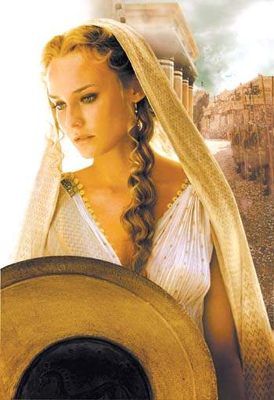
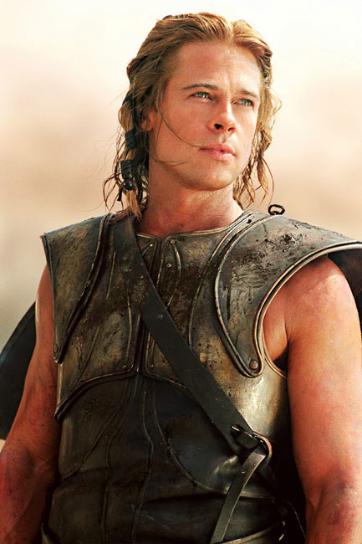
Atlanta, a princess
The Greek Goddess of Love
princess
Hippomenes

Slide 70
1.Skim the text and find out the main idea of the story.
Using language
a princess
The story is about ___________who races to marry the man that can run _____than her. In order to ____the race, a man asks for ____ from the Goddess of Love.
faster
win
help

Slide 71
Using language
2.Scan the passage and find the answers
1.Who was Atlanta?
2.What was she good at?
3.Who did she want to marry?
4.How could Hippomenes win Atlanta?
She was a Greek princess.
She was good at running
She wanted to marry a man who could run faster than her.
He ______________from the Greek Goddess of Love. The Greek Goddess of Love gave him __________________to attract Atlanta’s__________and make her ______________.
asked for help
three golden apples
attention
slow down

Slide 72
3.Finish the following true or false exercise after listening.
F
1. She practised running to compete in the Olympic Games.
2. At first Hippomenes understood why men ran against Atlanta.
3. Atlanta was not sure she could win.
4. She was so angry about the fact that she could not run in the Olympics.
5. She made as many men as she could share her pain.
6. Her father did not understand her wish to compete in the Olympics.
7. He did not refuse her wish to choose her husband in a race.
F
F
T
T
T
T

Slide 73
Language points
for reading II

Slide 74
Using language
Language points for Reading II
1. marry v. 结婚,嫁,娶
A marry B
Mary married a rich Frenchman last year.
marry A to B 把A 嫁给B
He married both his daughters to a writer.
adj. married
A get/ be married (to B)
She has been married for two years.
She got married two years ago.
n. marriage

Slide 75
Using language
2. amazed= surprised
be amazed at sth
be amazed to do sth
be amazed that…
I was amazed at zhang Zhan’s death.
I was amazed to hear about his death.
I was amazed that he had passed away.
amazing = surprising 令人惊奇的

Slide 76
Using language
3. promise v. 许诺，答应
promise sth
He promised a gift for my birthday.
promise sb sth
He promised me a gift for my birthday.
promise (sb) to do sth
He promised to buy me a mp3.
promise sb that…
He promised that he would buy me a mp3.

Slide 77
Using language
make/ give a promise 许下诺言
keep a promise 遵守诺言
carry out a promise 履行诺言
break a promise 违背诺言

Slide 78
Writing
原句1
I lived in what you call “Ancient Greece” and I used to write
about the Olympic Games a long time ago. 我生活在你们所说的
“古希腊”，我曾经写过很久以前奥林匹克运动会的情况。

Slide 79
点评
这个长句是由三个简单句合并而成：
①I lived in a place.
②You call the place “Ancient Greece”．
③I used to write about the Olympic Games a long time ago.
合并之第一步：句②中的 place 指的正是句①中的宾语，故
句②可转换为句①的宾语从句：I lived in what you call “Ancient
Greece”．
合并之第二步：句③与句①构成并列关系，可用并列连词
and 合并。

Slide 80
仿写
①他遇到一个乞丐在拉小提琴，他被他的琴声吸引了。
He met a beggar who was playing the violin and he was
________________________________________________
________________________________________________
②我感激父母为我所做的一切，同时我会更加努力学习。
absorbed into it.
I thank my parents for what they have done for me and I
________________________________________________
________________________________________________
will study harder.

Slide 81
原句2
Many kings and princes wanted to marry Atlanta, but when
they heard of her rules they knew it was hopeless.许多国王和王子
想要娶亚特兰大，但是当听到她规定的条件时，他们知道是没
有希望的。

Slide 82
点评
这个长句是由三个简单句合并而成：
①Many kings and princes wanted to marry Atlanta.
②They heard of her rules.
③They knew it was hopeless.
合并之第一步：句②中和句③在时间上是有先后顺序的，
可用 when 引导句②作为句③的时间状语：When they heard of
her rules they knew it was hopeless。
合并之第二步：句②③和句①之间构成转折关系，可用转
折连词 but 将他们合并起来。

Slide 83
仿写
①我的表姐曾经想当一名体操运动员，但当她听说训练很
辛苦时，她放弃了这个想法。
My cousin ever wanted to be a gymnast, but when she heard
__________________________________________________
__________________________________________________
②每个人都想尽快到达那里，但当他们遇上暴雨时，他们
the drill was very hard she gave it up.
不得不停下前进的步伐。
Everyone wanted to get there as soon as possible, but when they
__________________________________________________
__________________________________________________
met a storm they had to stop going on.

Slide 84
【小试牛刀】
[写作内容]
请根据下表信息，写一篇短文介绍你最喜欢的运动。
最喜欢的运动 | 篮球
开始产生兴趣 | 9 岁，那时父亲教我打篮球
现在练习情况 | 校篮球队成员； 放学后或周末打一小时
喜欢的原因 | 快乐；健康；可以交到朋友
最喜欢的篮球明星 | 姚明；乔丹

Slide 85
[写作要求]
只能用 5 个句子表达全部内容。
参考范文：
Basketball is my favourite sport.I first became interested in
basketball at the age of nine, when my father taught me how to play
basketball.Now I am a member of our school basketball team and I
often play basketball for about an hour after school or on
weekends.The reason why I like it so much is that it cannot only
bring me lots of happiness and health but also friends.My favourite
basketball star is Yao Ming although I also like Jordan.

